Slide 1
Analysis of mid-quarter evaluations
Office of Educational Assessment
UW Information Technology

Slide 2
Survey items and approaches
Survey items analyzed
(1) What is helping you to learn in this course?
(2) What is hindering your learning in this course?
(3) What can your instructor do to improve your learning in this course?
Approaches
Inductive process of constant comparison to identify themes (OEA)
500 randomly selected responses
Topic modeling (Latent Dirichlet Allocation) to identify common topics (UW-IT)
Analyzed complete data set

Slide 3
Sample
Courses with fewer than seven student responses were excluded
Themes across the three campuses were indistinguishable
This presentation includes responses from the Seattle campus
Question | Total Responses | Number of Courses | Avg N of responses per Course | Avg N of words per response
What is helping you to learn in this course? | 11420 | 534 | 21.39 | 16.67
What is hindering your learning in this course? | 10561 | 502 | 21.04 | 24.5
What can your instructor do to improve your learning in this course? | 9860 | 477 | 20.67 | 24.82
Total | 31841 | 1513 | 21.04 | 21.79

Slide 4
What is helping you to learn in this course?
Three topics/themes were identified in both analyses
1. Instructor ability to provide sufficient course material and resources
Students mentioned worksheets, office hours, example problems/exams, textbooks
2. Available lecture material and course interaction
Ability to view organized and engaging videos, recordings, readings weekly
3. Group work
Students mention group discussions, breakout rooms/ groups, guest speakers, group projects

Slide 5
What is helping you to learn in this course?
The topics were equally important

Slide 6
What is helping you to learn in this course?
Additional themes identified in the qualitative analysis were:
1. Overall course organization/expectations
syllabus, access to course materials, Canvas
2. Assessments
homework assignments, quizzes, tests
3. Class discussions
4. Instructor engagement and flexibility

Slide 7
What is helping you to learn in this course?
One-third of respondents in the qualitative analysis mentioned an aspect of the course specific to online learning. The most frequent responses were:
Convenience of recorded lectures (e.g., Panopto, Zoom)
Additional online resources provided or recommended (e.g., YouTube, Khan Academy)
Breakout rooms/online study groups
Online format (e.g., class adapted well, like to work at own pace)
Online office hours/online meeting with professors
Online discussion boards (e.g., Piazza, Slack)

Slide 8
What is helping you to learn in this course?
“The lectures are easy to follow and I like that the problem sets require me to really think about what I learned and how to apply that to actual problems. It helps the information stick with me better.”
“Attending the lectures and reading the course material is helpful in learning about the material.”
“The clearly laid out syllabus and the lectures.”
“Organized modules for each week and consistent lab due dates.”
“Clear link between lectures and assignments. Clear expectations.”
“The instructor uploads his notes and Powerpoints shortly after each class, which is a good reference for me.”

Slide 9
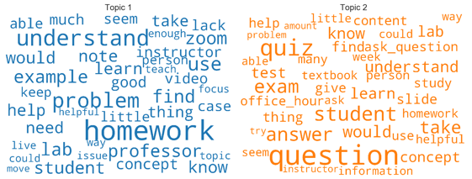
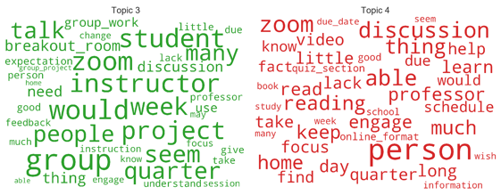
What is hindering your learning in this course?
Five topics identified; topics 1-4 are most important
Topic pairs 1 & 2 focus on course content & instructor interaction
Topic pairs 3 & 4 focus on personal issues & peer interaction
Terms that occur often within all topics include: zoom, canvas, talk, amount, understand, overwhelm, engage

Slide 10
What is hindering your learning in this course?
Qualitative findings echo the topic modeling results and identified additional themes:
One-quarter of respondents mentioned issues surrounding course structure and organization broadly defined. Respondents commented on course pace, lecture length, grading, and expectations
Around 15% of respondents mentioned course content including challenging material, unclear explanations, and excessive workload
Approximately 20% of respondents explained that they prefer in-person learning, noting that they generally find online courses less engaging and harder to focus on

Slide 11
What is hindering your learning in this course?
In addition to a general preference for in-person learning, around 20% of respondents also commented on the following aspects of online learning as hindrances to their learning:
Issues with technology (e.g., internet speed, insufficient hardware, poor recordings)
Feelings of disconnect with classmates and/or professors
Limitations of online discussion (e.g., unnatural conversation, hard to ask questions, hear other students)
Studios/labs/field experience not as effective
Breakout groups are ineffective (e.g., students don’t participate, hard to communicate)
Currently residing in different time zone

Slide 12
What is hindering your learning in this course?
“Online learning, the lectures are not entirely beneficial given that they rarely go through examples and when they do go over examples it takes up a lot of time to go over only one. ”
“Lack of motivation, inability to communicate with my team as often as needed, miscommunication because of shortened meet times... feeling like I can not do enough, no class life balance, long hours of screen time causing sleep problems, and (instructors) adding to the difficulty.”
“Setting up these sessions outside of class hours is also more difficult as we do not have a physical space where this would have happened more naturally… this used to happen all the time with instructors as well as peers in the studio and significantly helped improve the learning process.”
“The workload for this course is significant between reading load, case analysis, discussion boards and memos. This leads to some weeks I'm picking and choosing what I can realistically get done.”
“I generally work better when I am around other people who are also working, so being isolated from my general friend and study groups has made my motivation much lower than it normally is.”

Slide 13
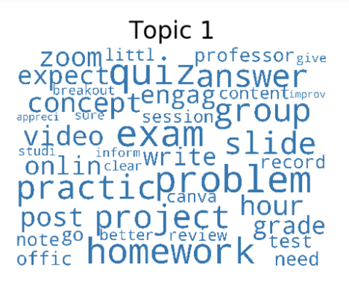
What can your instructor do to improve your learning in this course?
Six primary topics were identified
Topic 1, which focused on academics, was the most important topic
Comments focused on academics
More practice exercises
Reviewing and posting homework solutions
More notes on slides
Better explanations of concepts
Better defining group projects

Slide 14
What can your instructor do to improve your learning in this course?
Additional five topics related to online learning
Reduce the use of breakout rooms
Demonstrate problems step-by-step and slow the pace
Additional office hours and more active email communication
Recording of the lectures
Greater flexibility with grades and due dates

Slide 15
Key takeaways
What is helping learning
Courses that are well-organized with clear expectations, and provide high-quality assessments, example problems and exams
The convenience of recorded lectures, additional online resources (YouTube, Khan Academy), and breakout rooms/online study groups
Instructors’ passion for the material as well as their understanding and flexibility during the pandemic and transition to online learning
Interactions with the instructor and classmates, group projects, group discussions, breakout rooms/ groups, guest speakers

Slide 16
Key takeaways
What is hindering learning?
Course structure/organization including course pace, lecture length, grading, and expectations
Course content, subject matter, unclear explanations, and high workload
Aspects of online learning: issues with technology, feelings of disconnect between classmates and/or professors, limitations of online class discussion, ineffective breakout groups, and difficulty to engage and focus
An increase in stress and anxiety as a result of the pandemic, leading to difficulty focusing on schoolwork

Slide 17
Key takeaways
What can your instructor do to improve your learning?
Responses closely resembled responses to “What is helping you to learn in this course?”
Demonstrate problems step-by-step and slow the pace
Additional office hours and more active email communication
Recording of the lectures
Greater flexibility with grades and due dates
Additional material to enrich their learning, such as practice problems and exams, homework walkthroughs, more notes on slides and key concepts

Slide 18
Contributors and contact info
UW Information Technology
Henry Lyle, Ph.D. lyle3@uw.edu
Peter Seibel
Florencia Marcaccio
Office of Educational Assessment
Angela Davis-Unger, Ph.D. acd2@uw.edu

