Slide 1
Ask the Microsoft Infrastructure Team
October 2017
Nathan Dors, service owner
Brian Arkills, service manager
Bruce Edwards
Will Kaufman
Eric Kool-Brown
Patrick Lavielle
Kevin Lee
James Morris
Brian Smith

Slide 2
Questions? Unmet Business Needs?
Our goal: Provide infrastructure capabilities to enable Microsoft technologies. Microsoft Infrastructure capabilities provided are chosen based on the overall cost benefit to the university, often seeking to eliminate the need for customers to run their own.
What questions do you have about Microsoft Infrastructure capabilities?
What aren't we offering that you think we should?

Slide 3
Email response ideas
Azure Files Sync feature topic, Kole Kantner
  tiered storage,
  perform Azure Backup from the cloud-based copy,
  add cloud storage when you’ve run out of local storage capacity
  easily add additional file servers for capacity with synchronization
Windows file svc for restricted data, Matt Weatherford

Slide 4
Our topic ideas …
SCCM in NETID update, 3m
Office ProPlus device user activation update, 3m
Inactive user proposal--right approach?, 20m
Groups w/ Azure AD and O365--invest more?, 15m
General purpose delegated OU--good idea or bad?, 5m
Pass the Hash and other security mitigations, 5m
Computer joining refactor, 3m
Automate directory clean-up for delegated OUs?, 5m
Update about identity data sync modernization, 1m
Update on Azure AD applications, 5m
Update on ADFS upgrade, 5m

Slide 5
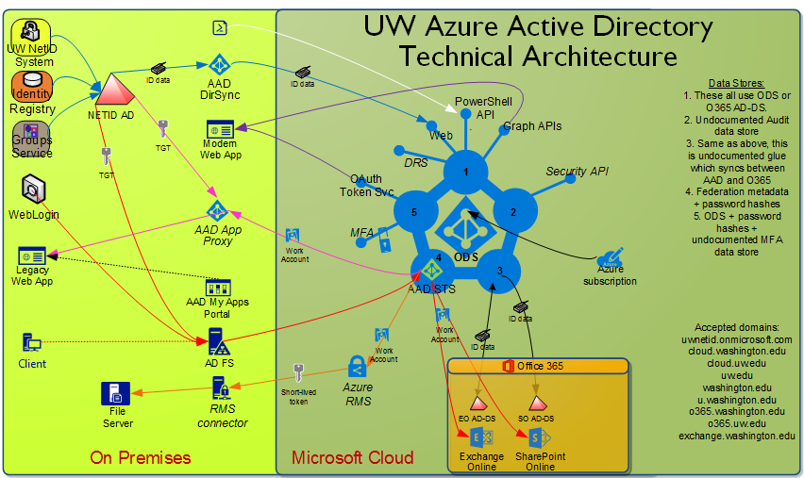

Slide 6
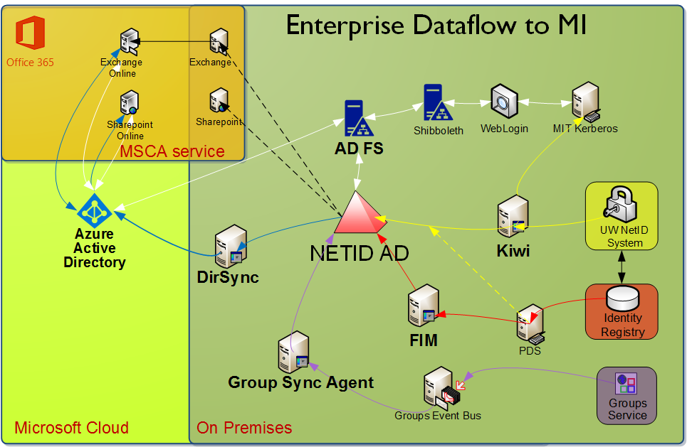

Slide 7
